Slide 1
LOVELY LISTS
The most commonly used component in Ionic…

Slide 2
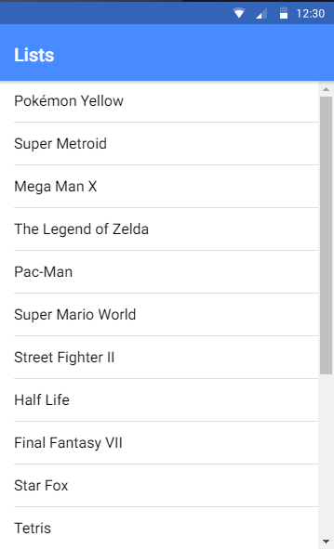
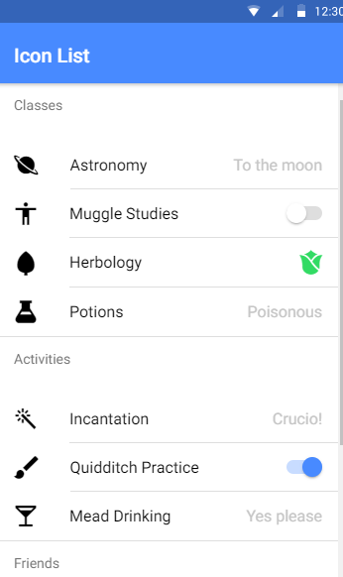
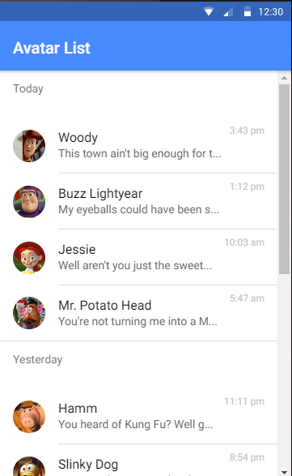

Lovely Lists
Let’s see one of the most commonly used components in Ionic…lists
Used to display rows of information, such as a contact list, playlist, or menu.
Look and feel of these lists is familiar to most smart phone users
There are many types of lists
Let’s add these to our app to display our past deliveries…

Slide 3
CHALLENGE TIME!
Take a look at the Ionic Docs and pick a list that will suit your mobile app.
Add this list to your mobile app in a fitting place.
Share a screenshot on our Discord Community!

